Slide 1
HOTEL MANAGEMENT SYSTEM
TEAM MEMBERS: Namitha Mariam John Nikitha Sarah John Sneha Mary Abraham Nanadana Anukumar

Slide 2
Problem definition
The Hotel Management System (HMS) automates various operations, improving efficiency and reducing errors. It streamlines room management, reservations, and billing processes. The centralized database ensures seamless information access, while advanced analytics provide valuable insights. The system prioritizes customer satisfaction by enhancing service delivery and addressing inquiries efficiently.Future enhancements may include mobile app integration, AI-powered analytics, and voice-activated interfaces to further elevate the user experience and optimize hotel operations.

Slide 3
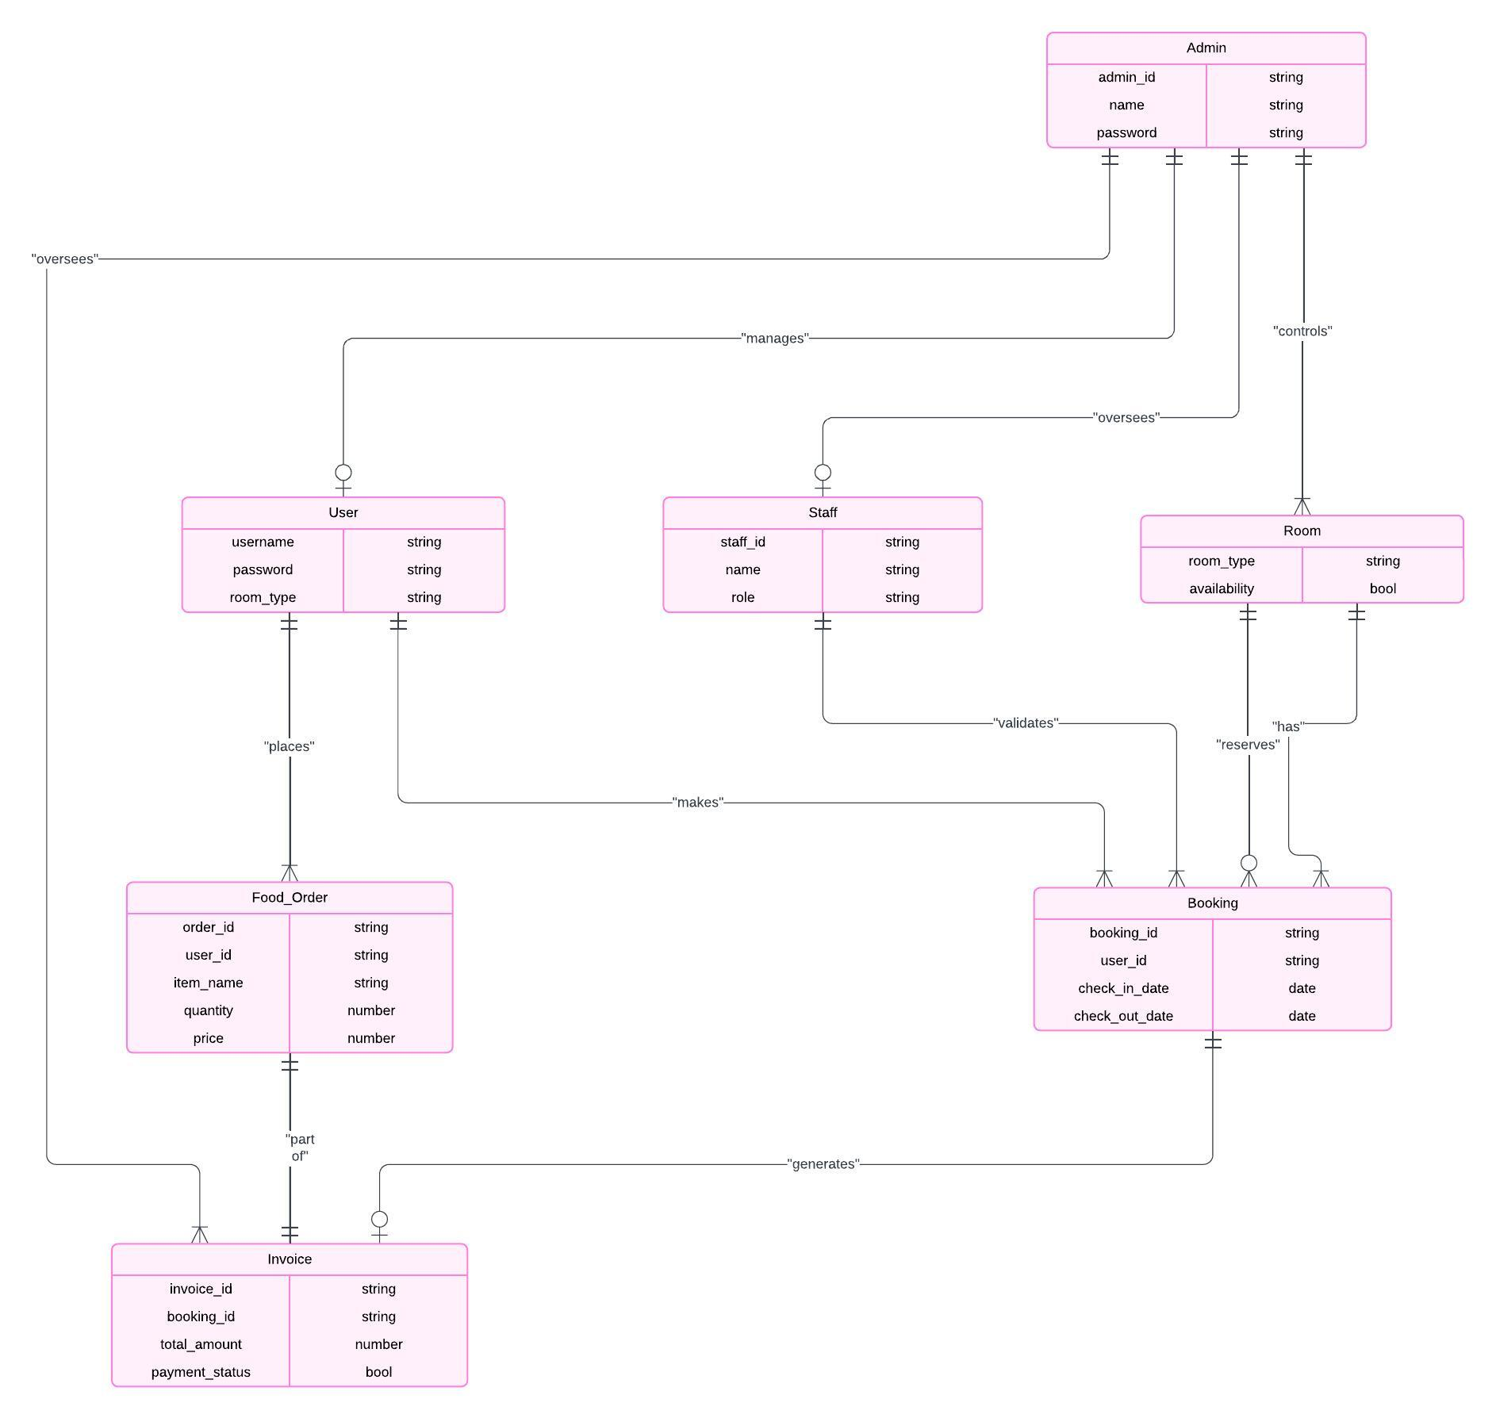
ER DIAGRAM

Slide 4
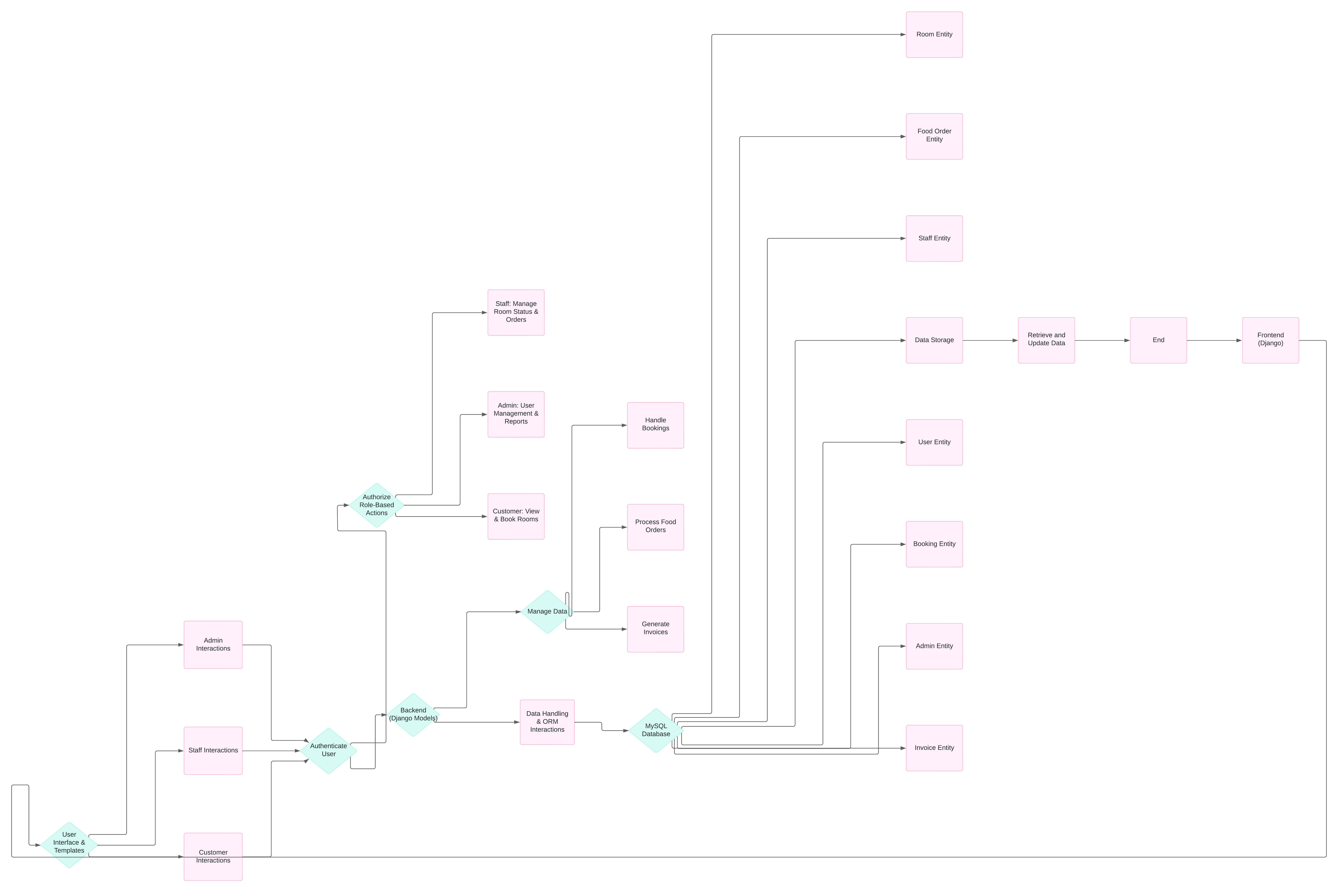
ARCHITECTURE DIAGRAM

Slide 5
FUNCTIONALITY ACHIEVED
The Hotel Management System developed using Python Django and MySQL has successfully achieved the following key functionalities:
User Module (Customer):
User registration and authentication with secure password management.
Room booking with options to select room types based on availability. Also has the provision for cancelling the bookings if needed.
Invoice generation for bookings with detailed cost breakdown and booking details.
Food ordering feature that allows users to select items, specify quantity, and view order totals.
Staff Module:
Verification and validation of customer bookings.
Management of check-ins and check-outs.
Overseeing room availability and updating room status in real-time.
Handling routine hotel operations to ensure smooth functioning.
Admin Module:
Comprehensive control over user and staff management.
Management of room types and their availability status.
Access to view, modify, and delete bookings and invoices.
Full oversight of food orders and payment statuses

Slide 6
FRONTEND/BACKEND SPECIFICATIONS
Frontend Specifications
Technologies Used: HTML, CSS, JavaScript for dynamic and responsive web pages.
Features:
User-friendly and intuitive design tailored for customers, staff, and admin interfaces.
Use of Django templates to render data dynamically and create interactive web pages.
Form submissions for booking, ordering, and administrative tasks.
Backend Specifications:
Framework: Python Django (Django ORM for database interactions)
Database: MySQL for structured data storage and relational database management.
Technologies Used:
Django models to represent and manage data entities (User, Staff, Admin, Room, Booking, Invoice, Food Order).
Secure user authentication system integrated with Django's built-in authentication mechanisms.
Business logic implemented in Django views to handle requests and interact with the database efficiently.

Slide 7
CONCLUSION
The Hotel Management System (HMS) developed in this project aims to address the challenges faced by traditional hotel
management practices. By automating various operations, streamlining processes, and providing valuable insights, the HMS significantly improves efficiency, reduces errors, and enhances customer satisfaction.
Key features and benefits of the HMS include:
Centralized Database: A unified database for storing and managing all hotel information.
Automated Operations: Streamlined processes for room management, reservations, and billing.
Enhanced Customer Service: Efficient handling of customer inquiries and requests.
Real-Time Insights: Data-driven reports and analytics for informed decision-making.
Security and Access Control: Robust security measures to protect sensitive information.
The successful implementation of this HMS will empower hotel staff to focus on providing exceptional customer
experiences, optimize resource utilization, and ultimately boost the overall profitability of the hotel.
Future enhancements may include integrating mobile applications, implementing advanced analytics, and exploring
opportunities for artificial intelligence and machine learning.

Slide 8
REFERENCES
Reference for developing ER Diagram – https://www.youtube.com/watch?v=G-hKyCYEJ3M
https://www.youtube.com/watch?v=pYYmvaKy-yQ
Error correction of the codes - https://gemini.google.com/app?hl=en-IN

